Slide 1
HOSPITAL MANAGEMENT SYSTEM

Slide 2
WEBSITE DESCRIPTION
We have tried to create very basic things which is necessary for a hospital website which gives a view of how actually hospital websites are.
Initially user is taken to a login page, if he’s not a user then he’s redirected to signup page.
After signup the user can login using the same credentials.
Upon successful login the user is taken to the home page.
User can see the Specializations,branches,etc.
User can take an appointment entering his details.
User can logout of his account upon which he’s redirected to initial login page

Slide 3
LINK TO OUR PROJECT:
Github link :-
https://github.com/Vimarsha23/webframeworks.git
Pythonanywhere link :-
http://vimarsha23.pythonanywhere.com/

Slide 4
CONTRIBUTION OF ALL TEAM MEMBERS
We all stayed back few days and did most of the things together
Archana: Model Creation, Templates
Vimarsha : login, Signup, Linking static pages
Vinutha : Creating Views, Linking Urls

Slide 5
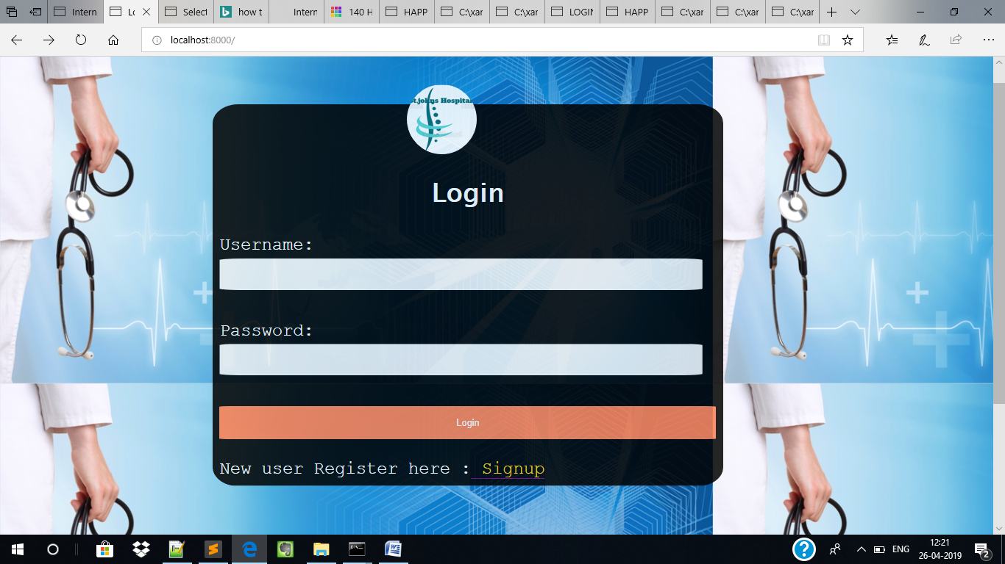
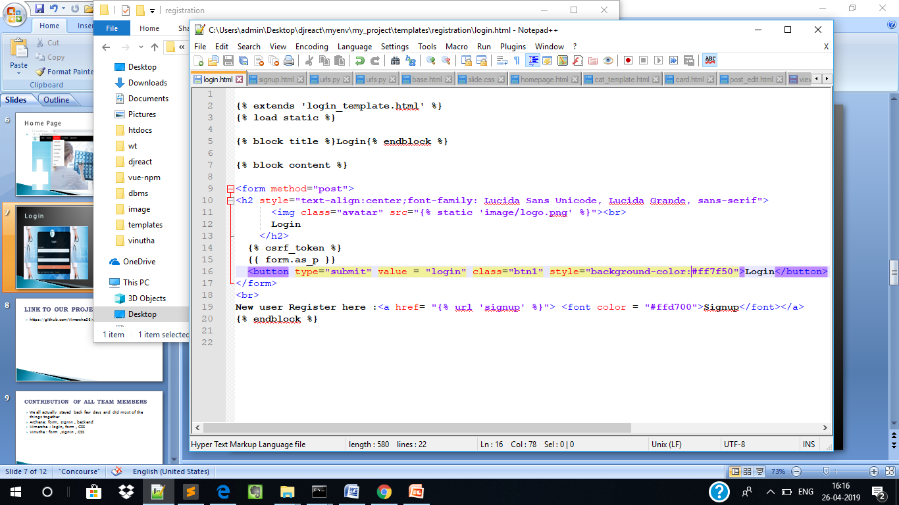
Login

Slide 6
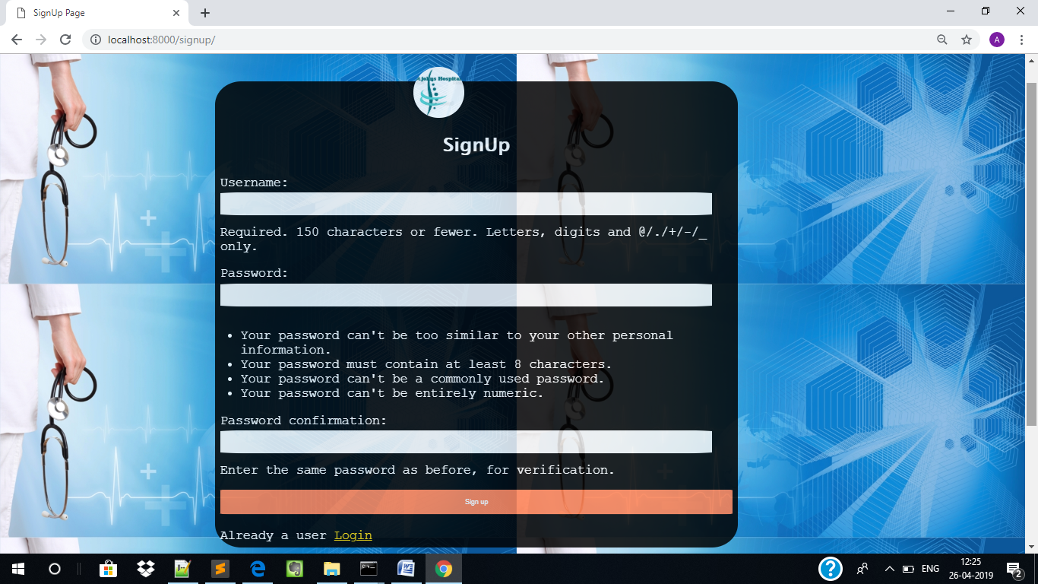
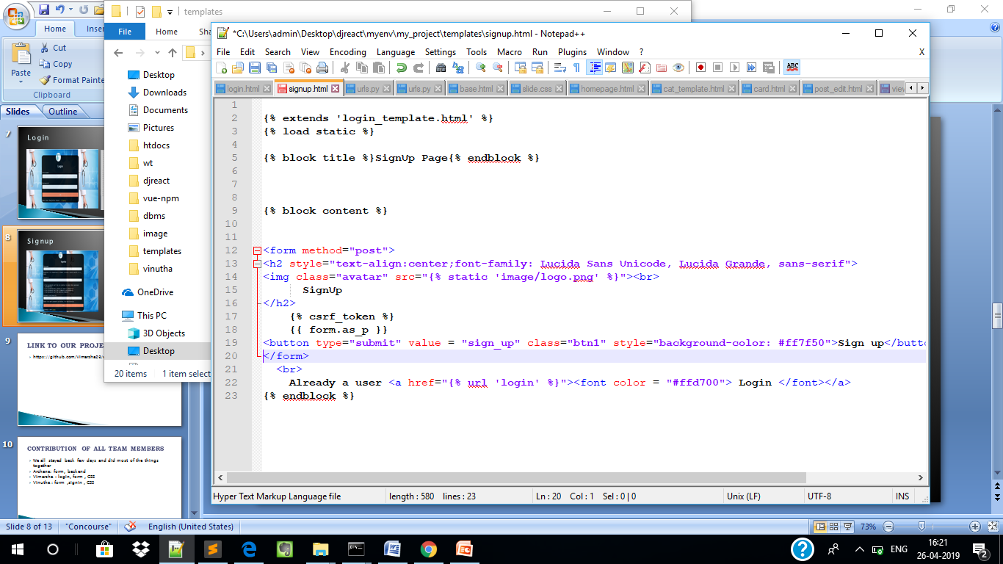
Signup

Slide 7
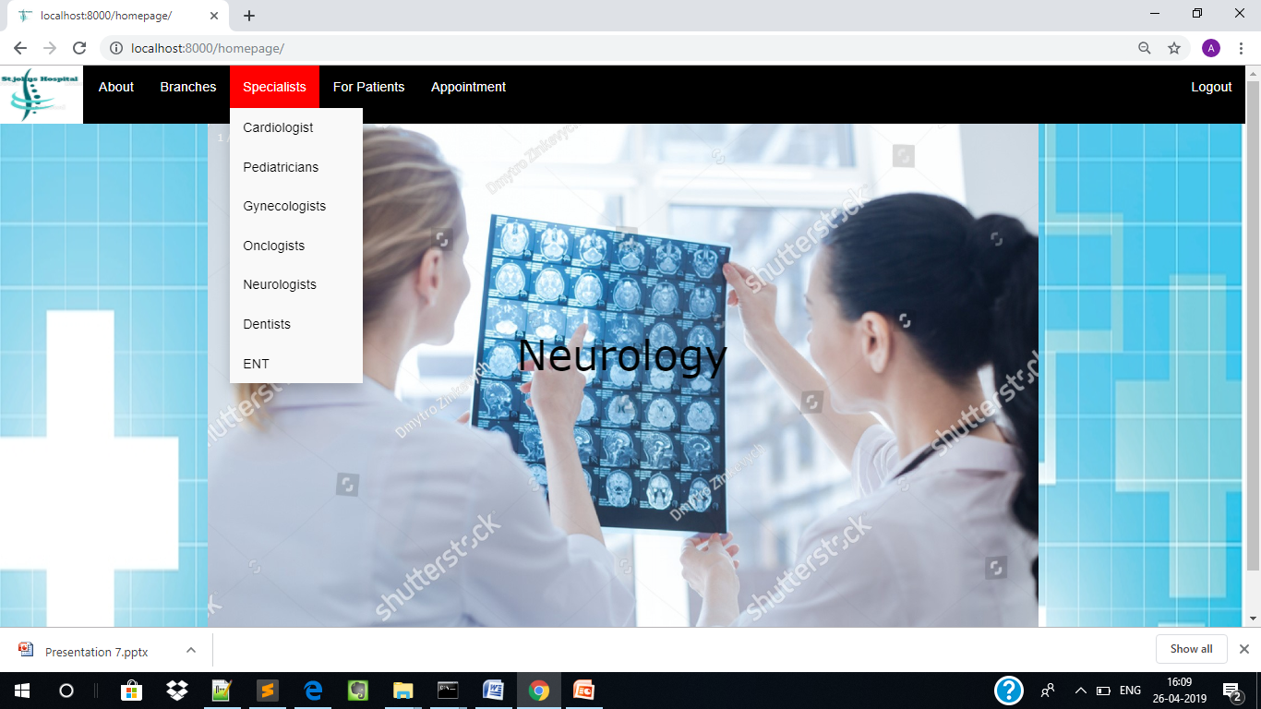
Home Page

Slide 8
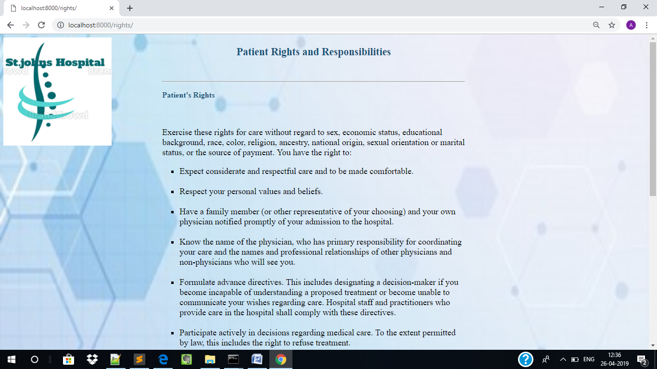
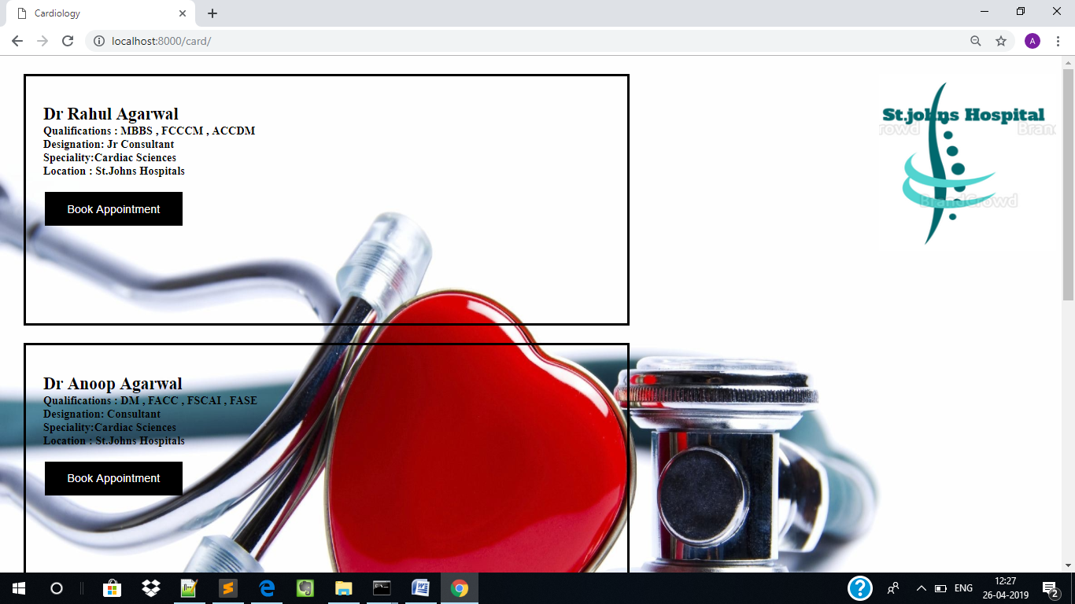
Specialization

Slide 9
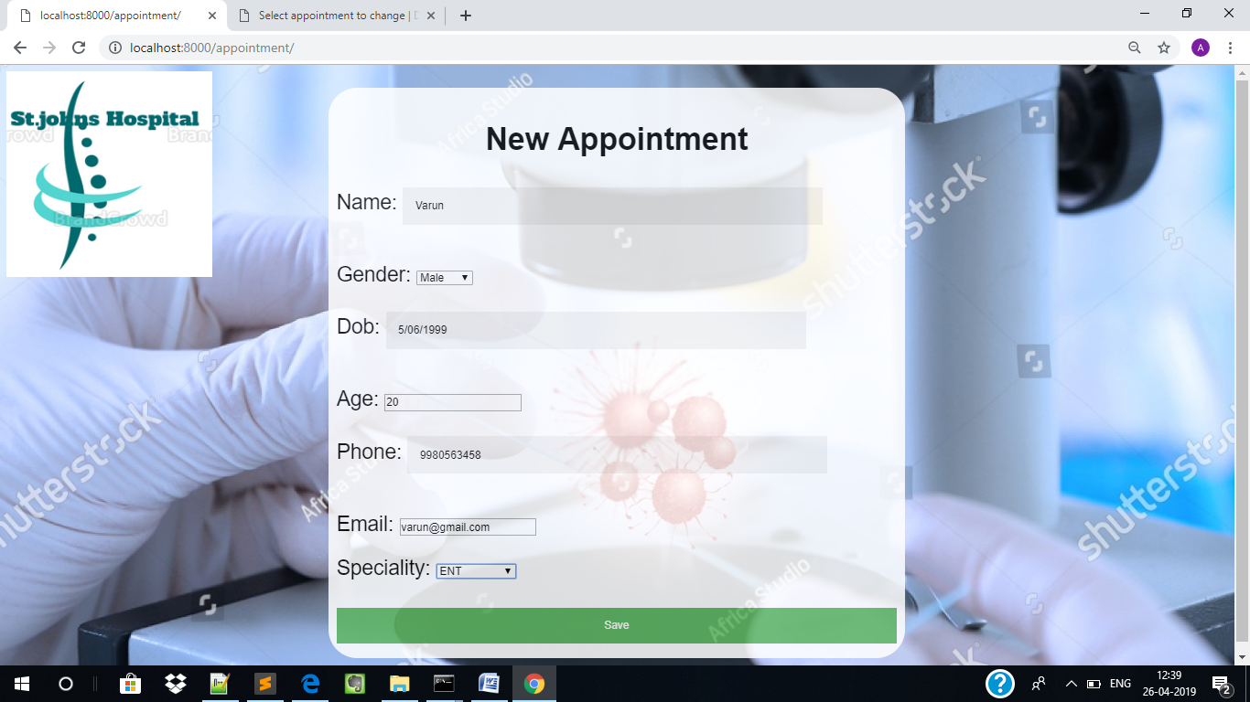
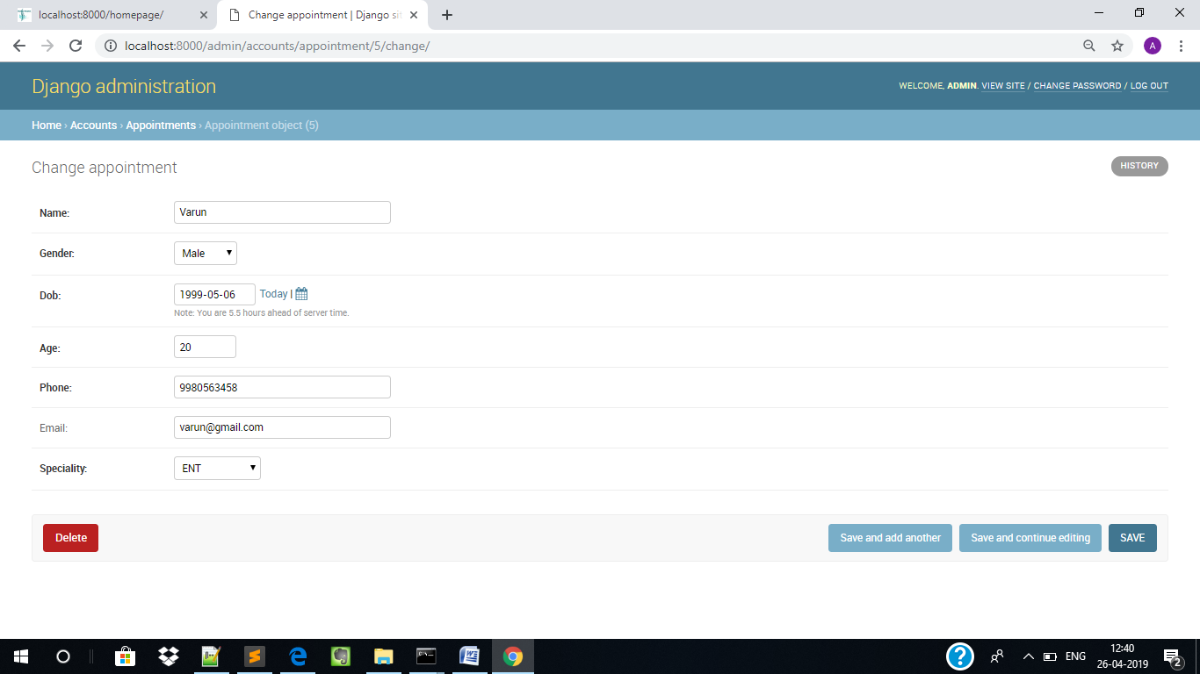
Model(Form)

Slide 10
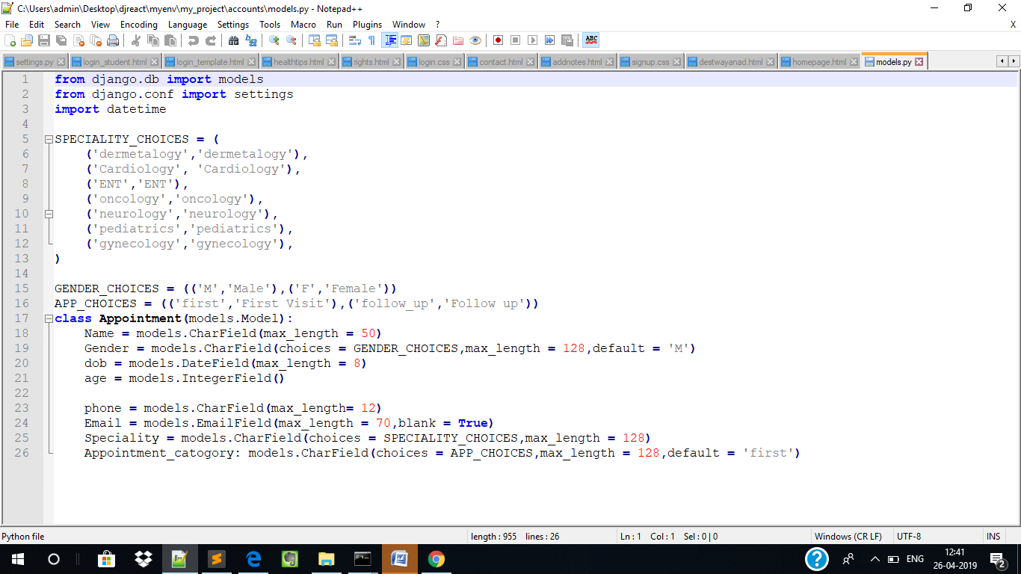
Code for model

Slide 11
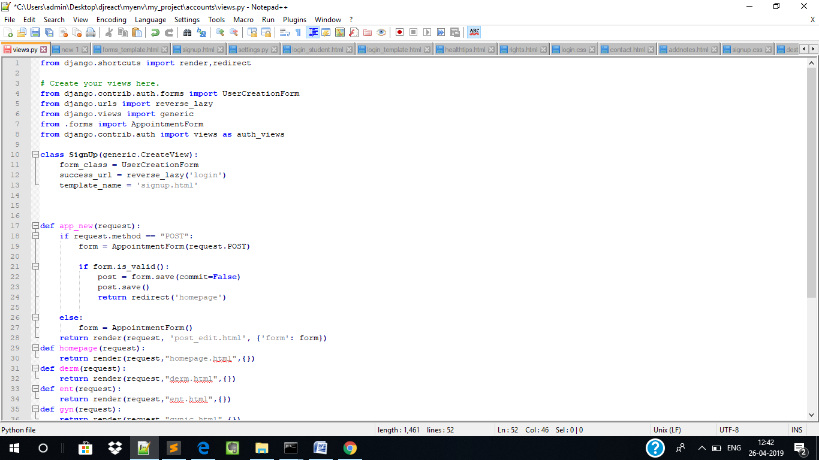
Code for Views and urls

Slide 12
TAKEAWAYS
It’s easy to create login and Signup pages because of django inbuilt authentication .
Using templates we don’t have to copy the same code for all pages .
Easier to create forms as we don’t have to mention all the input types ,values,etc.
Inserting data into our model was easier in django than in php.
It’s very important to place our contents in the specified path.
After completing our project we realized how easy django is compared to php.

Slide 13
Challenges
Since this was our first django project it took lot of time to figure out inbuilt libraries and how to use that in our project.
Creating Views to save the form was a bit difficult .
Writing Datatypes in the model for the fields which had radio buttons, dropdown box.
Adding static pages and images took a lot of time since we had placed that in a wrong folder.
Since we modified our old webtech project we had to change the links in anchor tag and src of images which consumed more time.

Slide 14
TEAM_MEMBERS_DETAILS:
NAME: Archana C
SRN : PES1201701384
EMAIL ID: archanac8799@gmail.com
NAME: Vinutha M N
SRN : PES1201701373
EMAIL ID: vinuthamn0909@gmail.com
NAME: Vimarsha R
SRN : PES1201701590
EMAIL ID : vimarsha.revanaradhya@gmail.com

